Slide 1
Presidential Elections: The Before and After
By Aalok Devkota, Abraham Ho,
Amy White, and Mikayla Kosmala
Team 5

Slide 2
The Questions
What are some basic trends of voters and whether or not they vote?
Does home prices, income and unemployment affect presidential votes?
Does the presidential approval rating correlate with crime rates in America?
Does unemployment rates affect presidential approval rating?

Slide 3
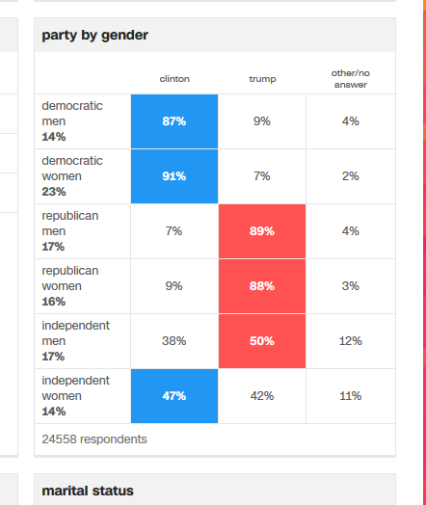
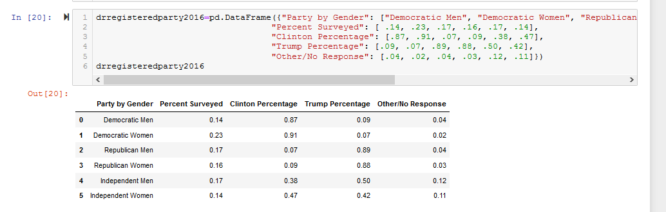
Sources and Code
CNN Exit Polls 2012 and 2016
https://www.cnn.com/election/2016/results/exit-polls
https://www.cnn.com/election/2012/results/race/president/
Used to create Data Frames in Pandas

Slide 4
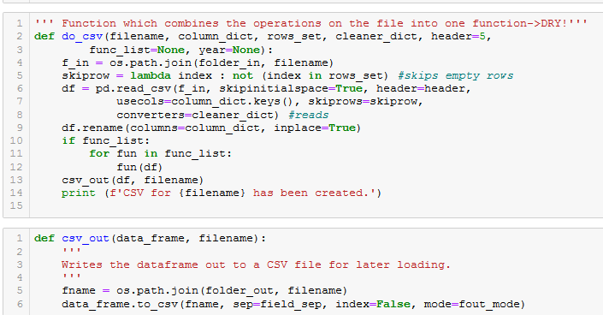
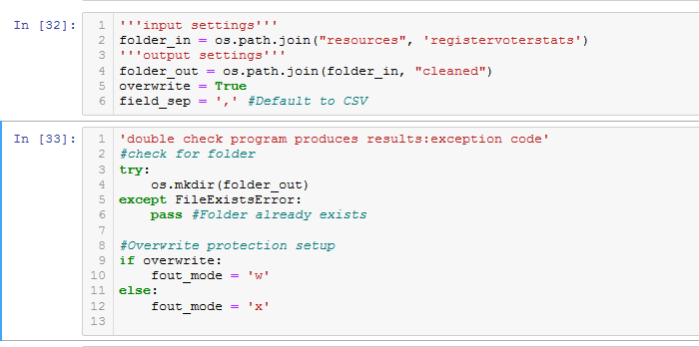
Code: Loops keep things DRY (Source & Code 2)
Census Data on Registered Voters for Age, Gender, Education, Ethnicity, and State LocationGraphs on Gender and Education, Age and Gender, and Ethnicity and State
Cleaning the code…,

Slide 5
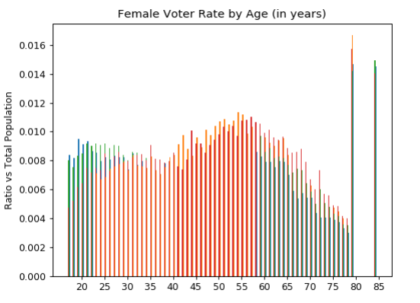
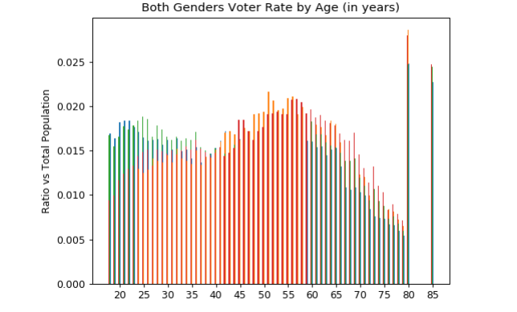
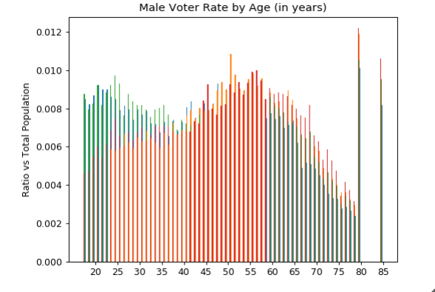
Results

Slide 6

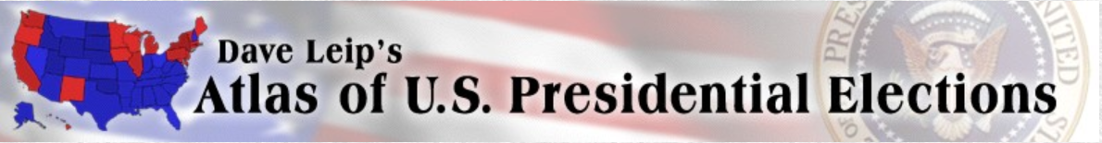
Does home prices, income and unemployment affect presidential votes?
St.Louis Fred Database: https://fred.stlouisfed.org/
US Election Results: https://uselectionatlas.org/

Slide 7
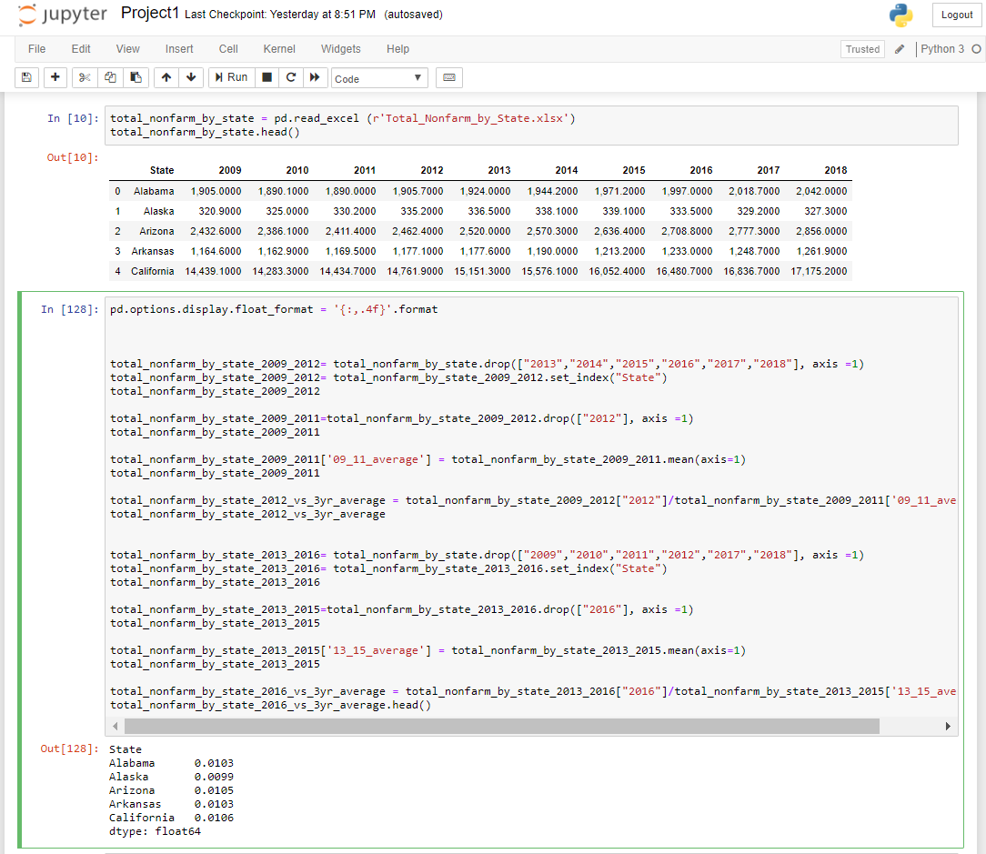
Sample data

Slide 8
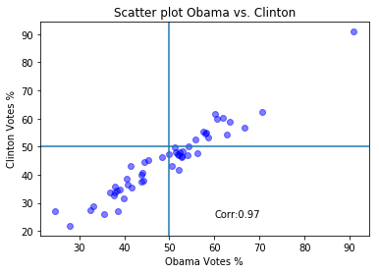
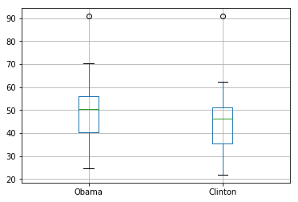
Election Results (Obama vs. Clinton)

Slide 9
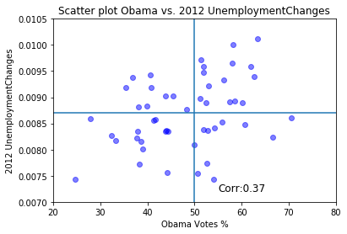
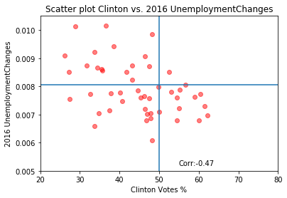
% of Votes vs. 3-yr. Change in Unemployment Rate

Slide 10
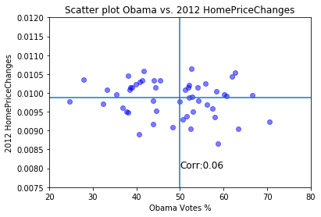
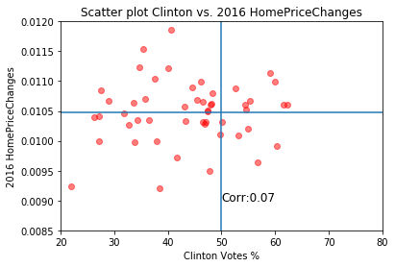
% of Votes vs. 3-yr. Change in Home Prices

Slide 11
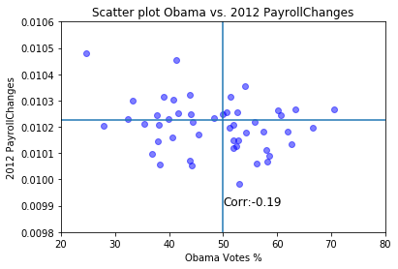
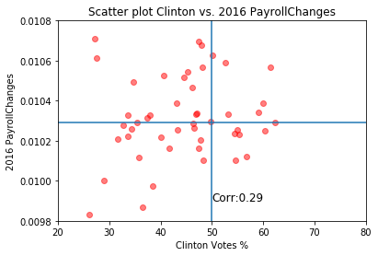
% of Votes vs. 3-yr. Change in Payroll

Slide 12
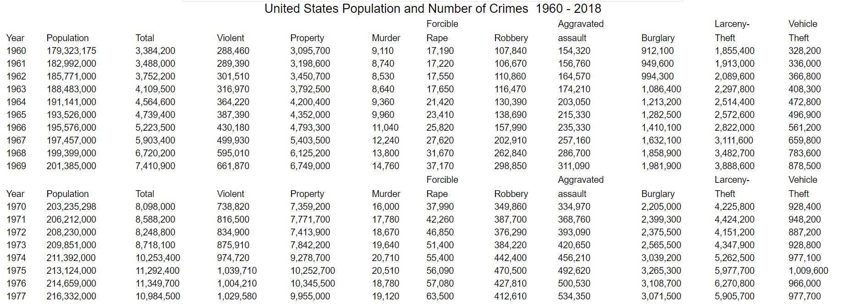
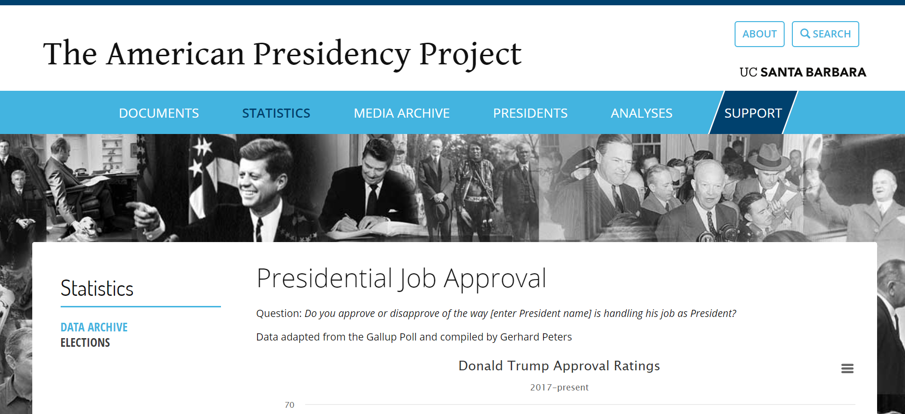
Does the Presidential Approval Rate correlate with crime rates in America?
Crime data was pulled off of DisasterCenter.com
Approval Rating data was pulled by Abraham from UCSB’s Presidency Data

Slide 13
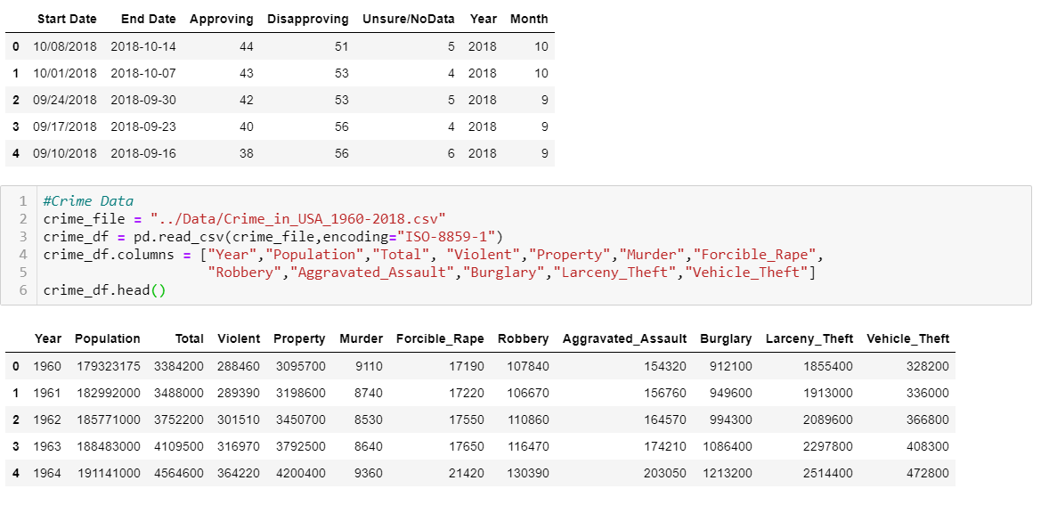
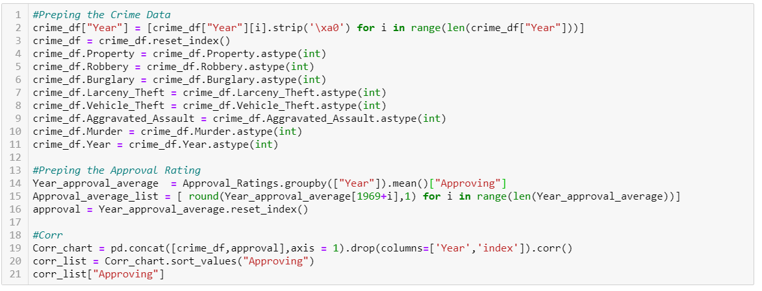
Approval Rating vs. Crime Rate Code

Slide 14
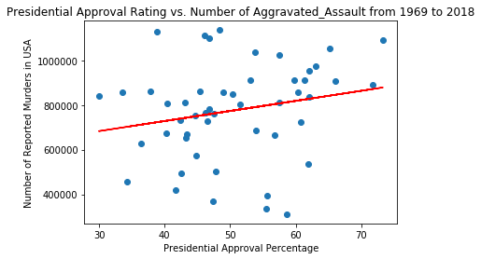
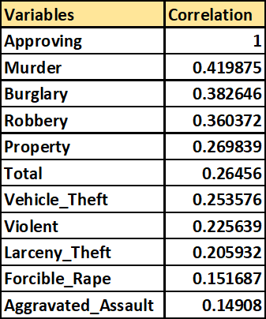
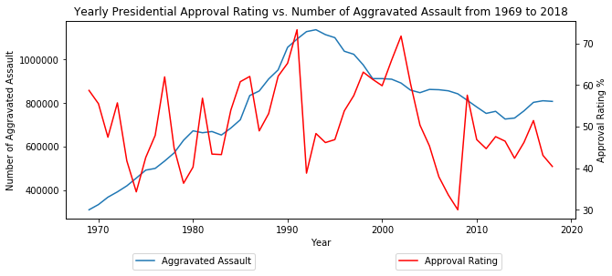
The Results
Notes:
Will add Linear regression line

Slide 15
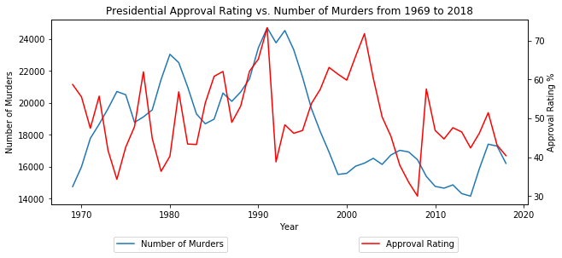
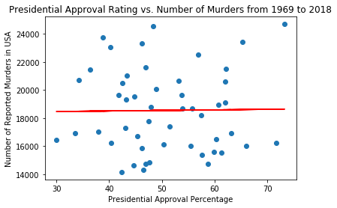
The Results
Notes:
Will add Linear regression line

Slide 16
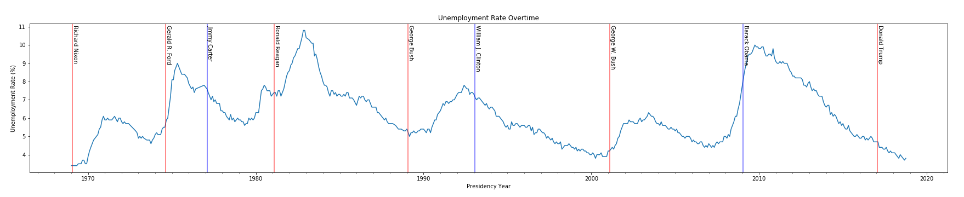
Does unemployment rates affect presidential approval rating?
The graph shows an unemployment cycle. (More information: https://www.thebalance.com/cyclical-unemployment-3305520)
Highest Unemployment in this period: Ronald Reagan (R)
Lowest Unemployment in this period: Richard Nixon (R)
Sources: https://www.presidency.ucsb.edu/statistics/data/presidential-job-approval https://www.bls.gov/
Notes:
Talk a bit about cyclical unemployment. Talk about how unemployment rate does not drastically change from elections.

Slide 17
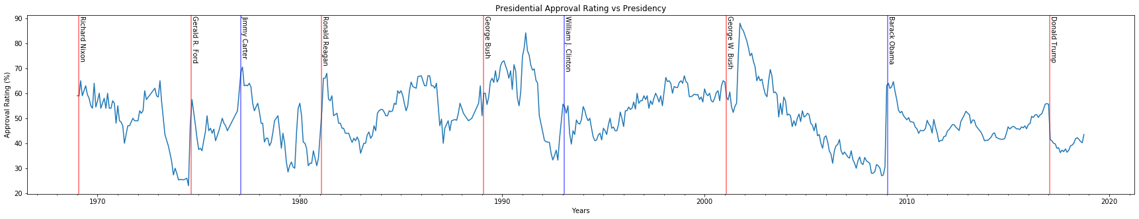
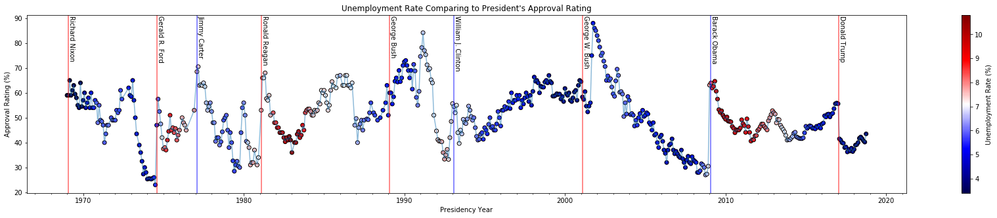
Unemployment Rate per Approval Ratings
Sources: https://www.presidency.ucsb.edu/statistics/data/presidential-job-approval https://www.bls.gov/
Notes:
re-introduce the approval ratings graph from a couple of slides ago. Talk about how the unemployment rate does not match a pattern with approval ratings.
Introduce new approval ratings graph to

Slide 18
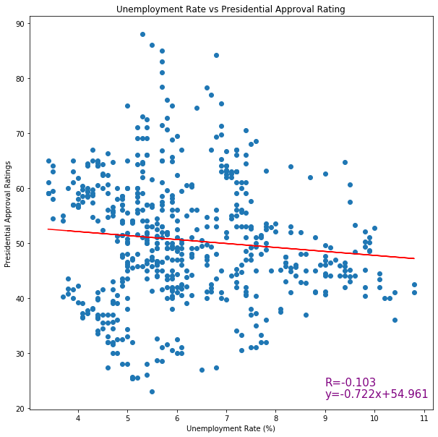
Does Unemployment Rate affect Presidential Ratings?
Very weak correlation
Expected Approval Ratings Chart: →
Does this make sense? Not really. Many factors like market crashes will affect unemployment rate and take years to fix.
Unemployment Rate (%) | Approval Rating
3% | 52.07%
4% | 51.35%
5% | 50.63%
6% | 49.90%
7% | 49.18%
8% | 48.46%
9% | 47.74%

Slide 19
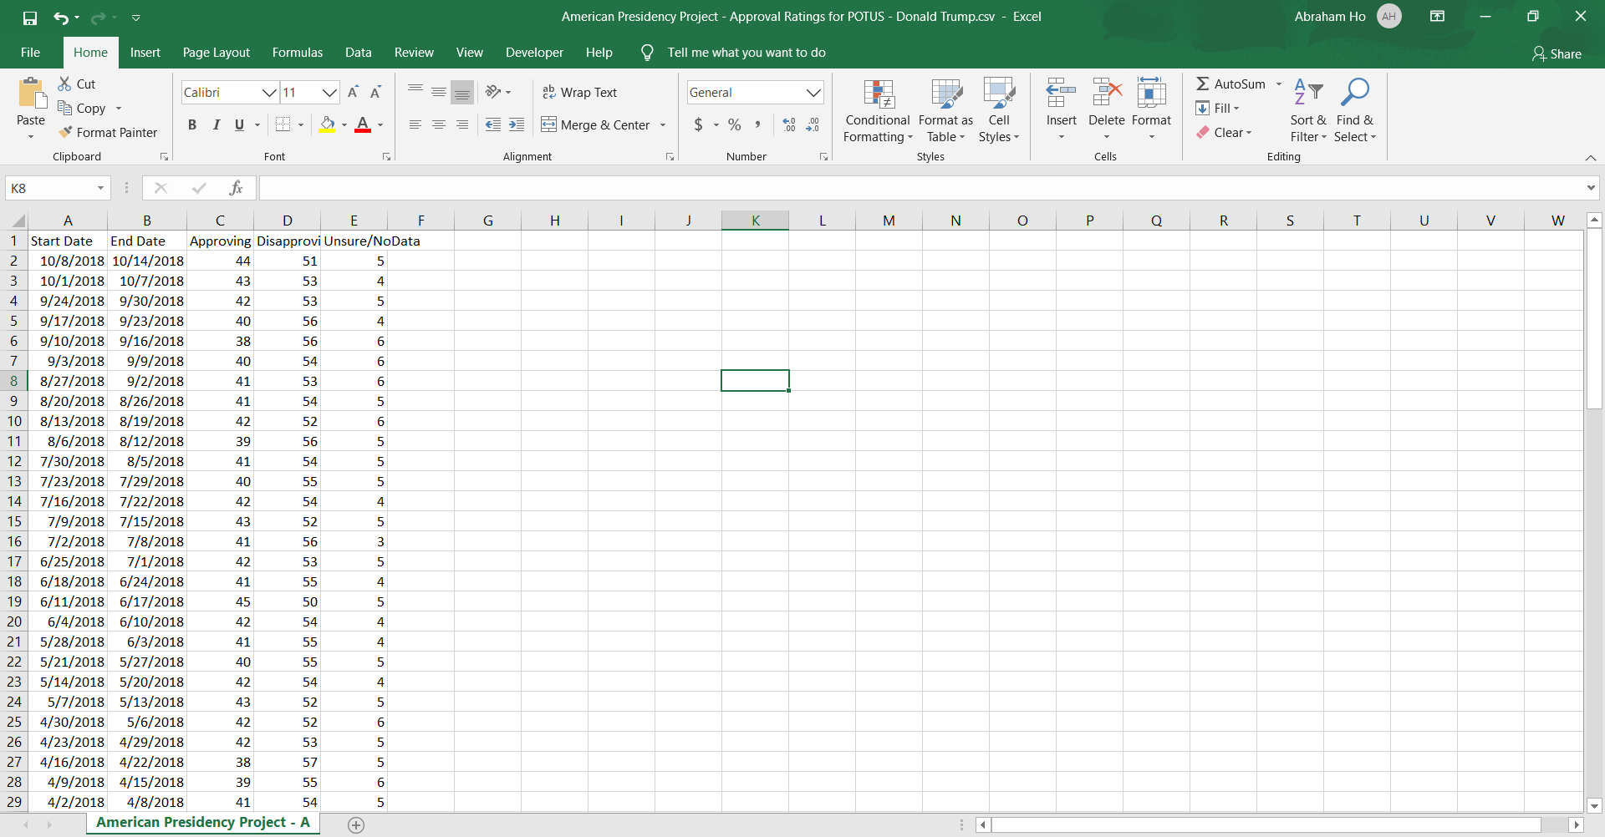
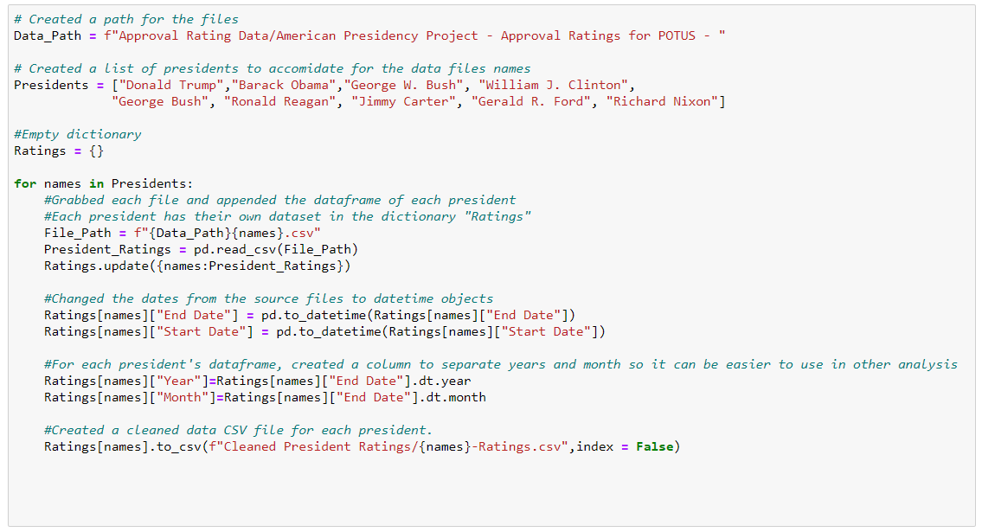
Cleaning Data (Approval Ratings)
https://www.presidency.ucsb.edu/statistics/data/presidential-job-approval
Notes:
Mention how the data path was created.
-One path, a list of presidents, combined in for loop

Slide 20
SUMMARY
There was no relationship between the change in unemployment rate, change in median home prices and change in payroll to the president votes in a state.
Obama was able to get more than 50% of votes in 15 states where the unemployment had increased more than average, whereas Clinton was able to carry just 1 state.
There is no strong correlation between approval rating and crime rates.
There is no indication of unemployment rates affecting presidential approval rating.

Slide 21
Questions?

